Slide 1

Introduction to hive
By Vasanti Mahajan

Slide 2
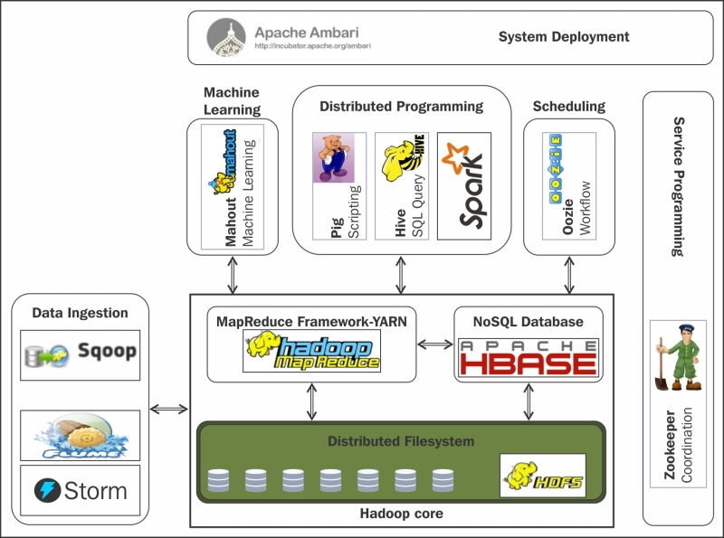
APACHE HADOOP ECOSYSTEM
Different ways of performing MapReduce operations:
Building a Java MapReduce program to process structured, semi-structured, and unstructured data
Building scripts in Pig to process structured and semi-structured data
Using HiveQL for MapReduce to process structured data using Hive

Slide 3
About hive
Apache Hive is a data warehouse infrastructure built on top of Hadoop for providing data summarization, query, and analysis. Hive gives an SQL-like interface to query data stored in various databases and file systems that integrate with Hadoop
Apache Hive provides the following features:
Access to files stored in Apache HDFS, Amazon S3, Apache HBase
Uses SQL-like language (HiveQL) which enables query execution via Apache Tez, Apache Spark, or MapReduce
Supports data in different formats such as, text files, Sequence files (key/value paired), RCFiles (stores columns of the table in the way columnar database stores data)
It is more suitable for running batch jobs over large sets of data i.e OLAP operations rather than OLTP operations

Slide 4
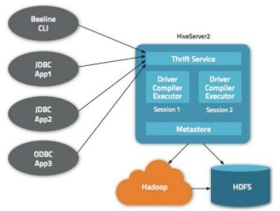
Hive architecture
Components and their interaction:
METASTORE: Stores the metadata for each of the table such as their schema, location, data types, HDFS mapping
DRIVER: Receives the HiveQL statements, creates a session and starts the execution of statements, monitors the life cycle and progress of execution. Stores the metadata that is generated in the metastore. Fetches the results generated by the Reduce operation. Driver has its components namely, Compiler, Optimizer and Executor.

Slide 5
Hive architecture (cont.)
Components and their interaction:
COMPILER: Complies the HQL query and converts it into an execution plan i.e determine the tasks and steps needed to be performed by MapReduce
OPTIMIZER: Perform transformations on the execution plan to optimize the operations
EXECUTOR: Execute the tasks by interacting with Hadoop’s job tracker
THRIFT SERVICES: Allows the interaction between clients and Hive

Slide 6
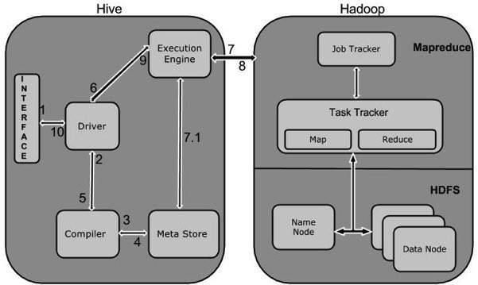
WORKING OF HIVE

Slide 7
INSTALLATION
Requirements
Java 1.7 (preferred)
Hadoop 2.x (preferred), 1.x (not supported by Hive 2.0.0 onward)
Hadoop running in distributed mode
Installation instructions on Windows/Mac/Linux
https://www.tutorialspoint.com/hive/hive_installation.htm
Installation instructions using Docker:
https://github.com/vasantivmahajan/Hadoop-Ecosystem
Refer the file Docker setup instructions for Hive.docx

Slide 8
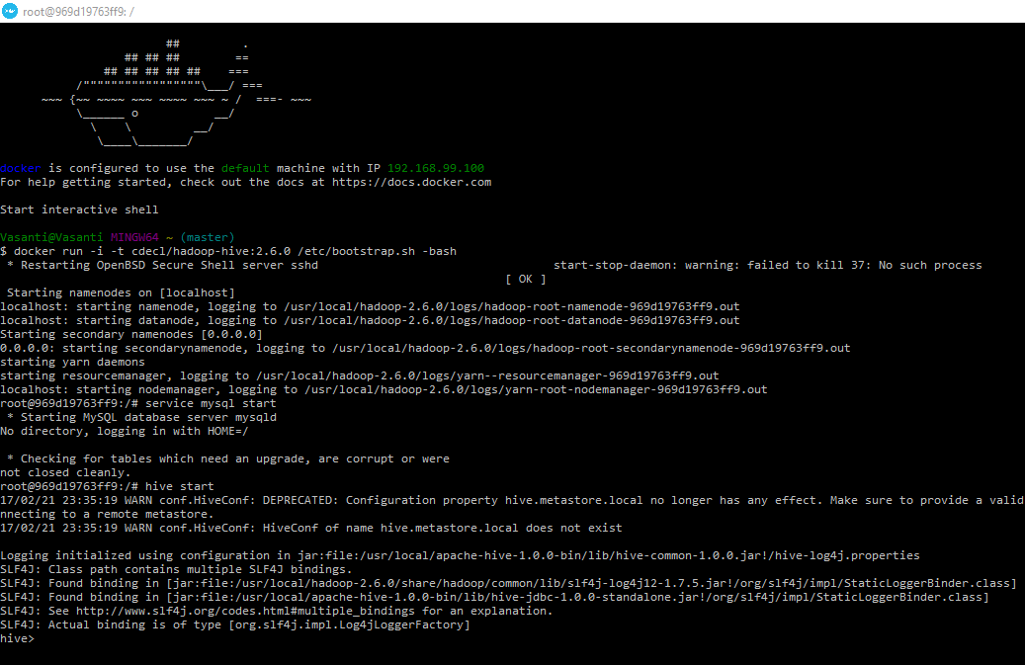
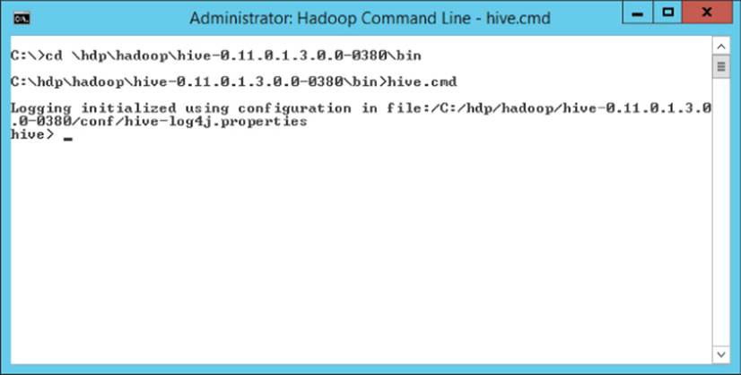
Begin with hive
On successfully installing Hive, the following should be displayed on the terminal:

Slide 9
SAMPLE example IN HIVE
Sample example:
The word count program counts the number of times each word occurs in the input. The same word count operation can be done using the HiveQL. One way to accomplish this is as follows:
DROP TABLE IF EXISTS docs; //checks if the table exists, if it does deletes the table
CREATE TABLE docs (line STRING); //creates a table named ‘docs’ with single column ‘line’ of type string
LOAD DATA INPATH 'input_file' OVERWRITE INTO TABLE docs; //loads the data into the table
CREATE TABLE word_counts AS //create a table ‘word_counts’ with two columns ‘word’ and ‘count’
SELECT word, count(1) AS count FROM
(SELECT explode(split(line, '\s')) AS word FROM docs) temp //splits the words into rows and inserts in into the ‘temp’ table
GROUP BY word //performs group by on the keys
ORDER BY word; //sorts the word alphabetically

Slide 10
CRUD operations
CREATE DATABASE : Create a database which is a collection of tables
CREATE DATABASE|SCHEMA [IF NOT EXISTS] <database name>
eg: hive> CREATE DATABASE [IF NOT EXISTS] userdb;
DROP DATABASE : Drop all tables and delete the database [RESTRICT|CASCADE];
DROP (DATABASE|SCHEMA) [IF EXISTS] <database_name>
eg: hive> DROP DATABASE IF EXISTS userdb CASCADE;
CREATE TABLE : Creates a table
CREATE [TEMPORARY] [EXTERNAL] TABLE [IF NOT EXISTS] [db_name.] table_name
[(col_name data_type [COMMENT col_comment], ...)]
[COMMENT table_comment]
[ROW FORMAT row_format]
[STORED AS file_format]

Slide 11
CRUD operations (CONT.)
CREATE TABLE : Creates a table
eg: hive> CREATE TABLE IF NOT EXISTS employee ( eid int, name String,
salary String, destination String)
COMMENT ‘Employee details’
ROW FORMAT DELIMITED
FIELDS TERMINATED BY ‘\t’
LINES TERMINATED BY ‘\n’
STORED AS TEXTFILE;
LOAD DATA: Inserts data into the table
LOAD DATA [LOCAL] INPATH 'filepath' [OVERWRITE] INTO TABLE tablename
[PARTITION (partcol1=val1, partcol2=val2 ...)]

Slide 12
CRUD operations (CONT.)
LOAD DATA: Inserts data into the table
eg: hive> LOAD DATA LOCAL INPATH '/home/user/sample.txt'
OVERWRITE INTO TABLE employee;
ALTER TABLE: We can alter the attributes of the table such as changing its table name, changing column names, adding columns and deleting or replacing columns
ALTER TABLE name RENAME TO new_name
ALTER TABLE name ADD COLUMNS (col_spec[, col_spec ...])
ALTER TABLE name DROP [COLUMN] column_name
ALTER TABLE name CHANGE column_name new_name new_type
DELETE TABLE: Drop a table which removes the table and column data along with their metadata
DROP TABLE [IF EXISTS] table_name;
eg: hive> DROP TABLE IF EXISTS employee;

Slide 13
references
https://www.tutorialspoint.com/hive/
https://en.wikipedia.org/wiki/Apache_Hive
https://baondp.wordpress.com/2015/10/13/build-hadoophive-developmentlearning-environment-on-docker/

Slide 14
conclusion
If you are already familiar with SQL working with Hadoop becomes very easy thanks to Apache Hive. To compare SQL and HiveQL refer to the below mentioned link
https://hortonworks.com/blog/hive-cheat-sheet-for-sql-users/
THANK YOU!!

